Slide 1


Slide 2
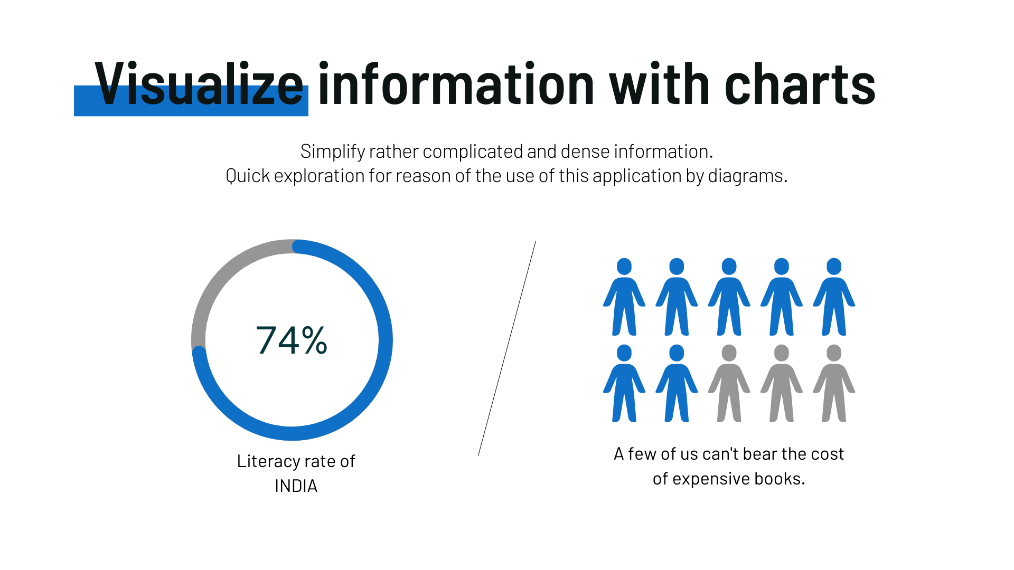
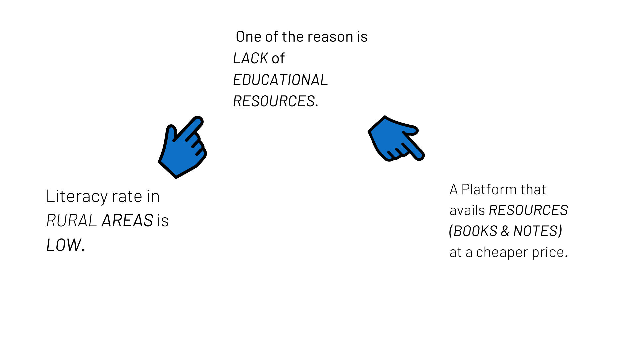
Problem

Slide 3

Solution
To resolve this issue we came up with the idea of developing an application (BOOKSERA) which would assist the oppressed by assisting them with free second hand/utilized books, leased books, and used books marked down at under 50 % MRP.

Slide 4
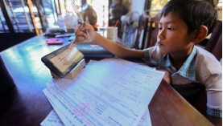
Impact
BOOKSERA points The Impact of Education for all.
The target of the application is to make learning a reality for kids from impoverished and distraught foundations (offspring of helpless specialists) in far-off regions.

Slide 5
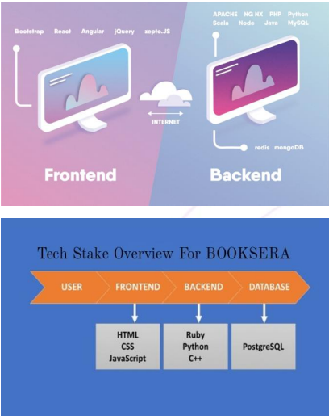
Tech Stack
Programming Language:
HTML, CSS, Python, JavaScript.
AI-backed Learning:
Chatbot’s and Google Analytics.
Database:
MySQL.
Server Side Framework:
Django.

Slide 6
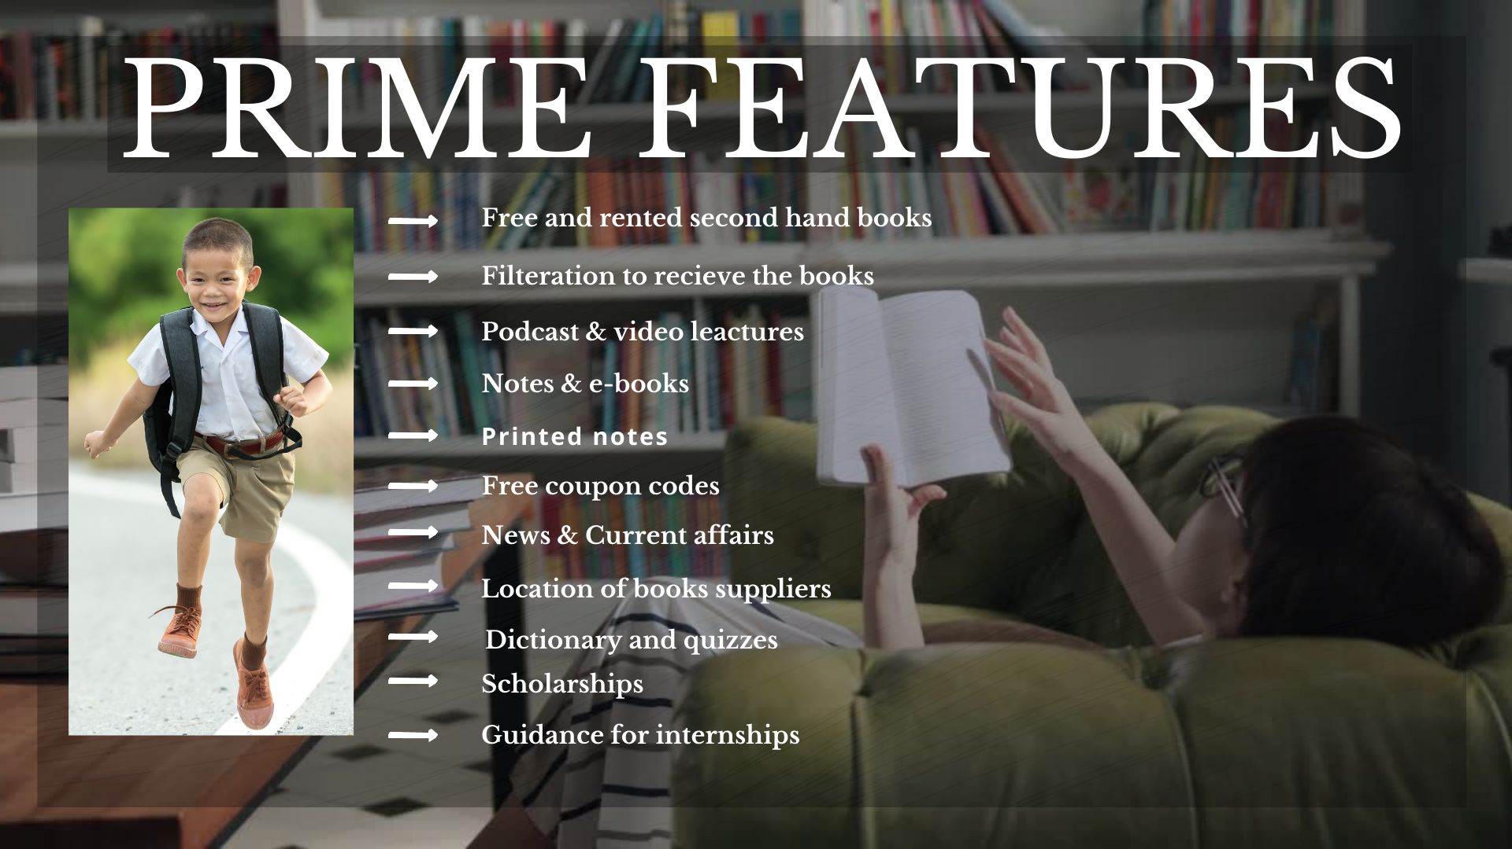

Slide 7
KEY ACTIVITIES
1.Managing partnerships with local book retailers
2.Manage supply chain & logistics 3.Development, design & optimization 4.Network of lender and receiver
KEY FEATURES
1.Free & Rented secondhand books
2.Location of book supplier
3.Filtration to find best &nearby options
4.Podcasts, video lectures, Notes & E-books
5.Quizzes & Dictionary
VALUE PROPOSITION
1.Selection of goods
2.Convenient to use
3.No minimum order requirement
4.Saving money, refer & earn, loyalty points
5.Wide reach
CUSTOMER RELATIONSHIP
1.Reviews & blogs
2.Customer service
3.Phone
4.Email
5.Social media pages
6.FAQ Section
CUSTOMER SEGMENT
1.Receivers/general user
2.Lender
3.Book retailers
KEY RESOURCES
1.Book Retailers
2.NGO’s
3.Shipping Services
4.Online Platform
REVENUE STREAM
1.Advertising revenue
2.Sales sponsors
3.Funding
CHANNEL
1.Online platform
2.Mobile application
3.Number(SMS, call etc.)
COST STRUCTURE
1.Technical set-up
2.Operational costs
3.Marketing
4.Employees
5.Hosting

Slide 8
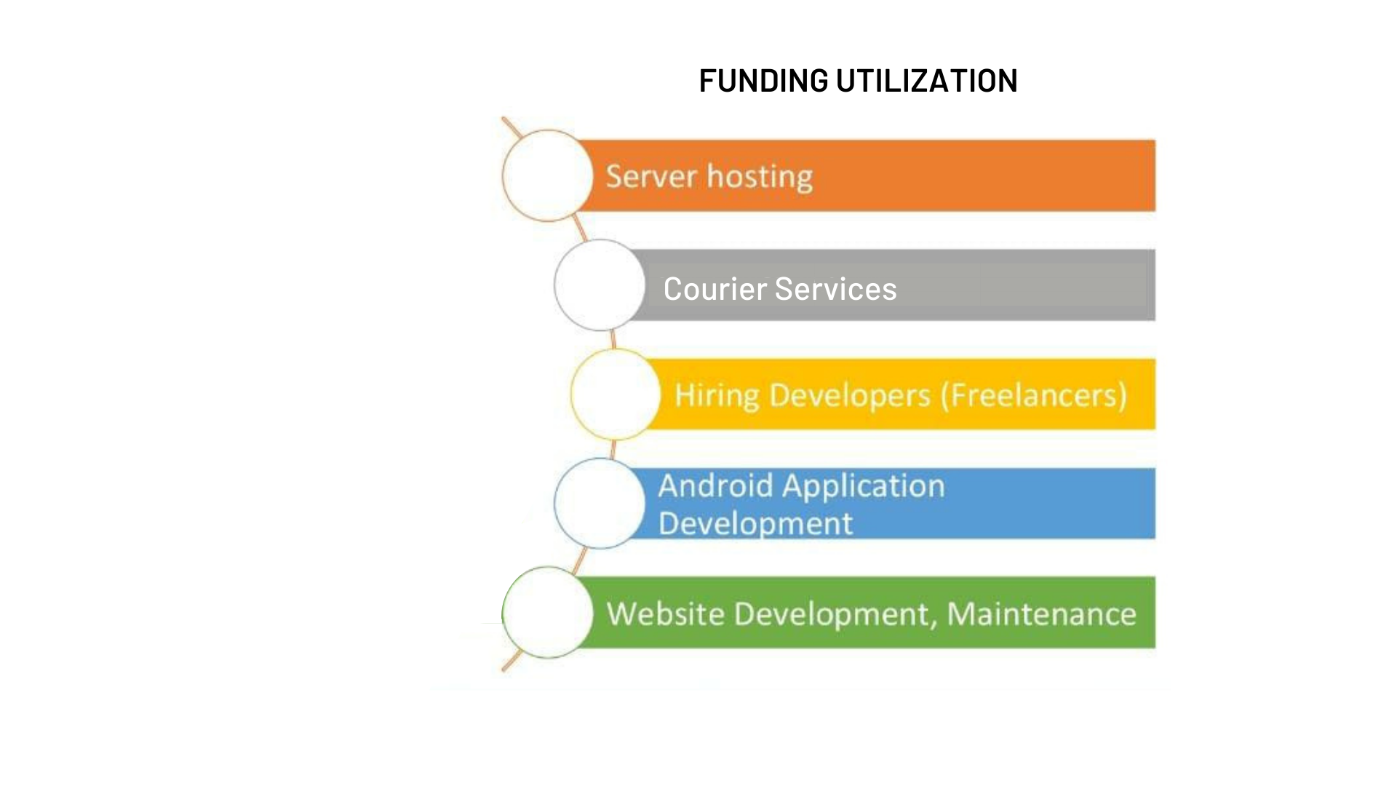
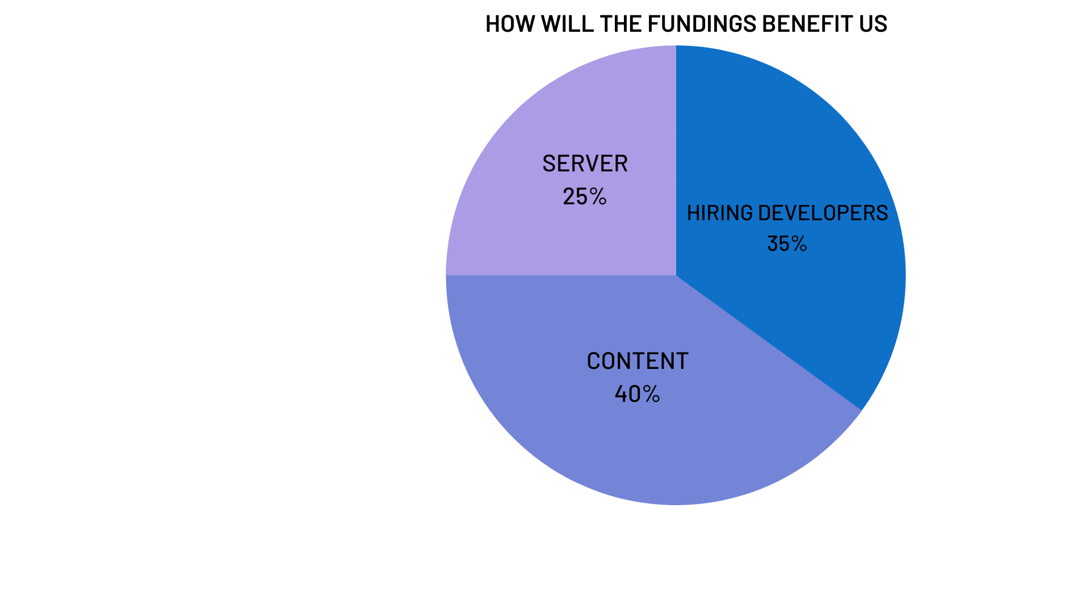
Business model

Slide 9
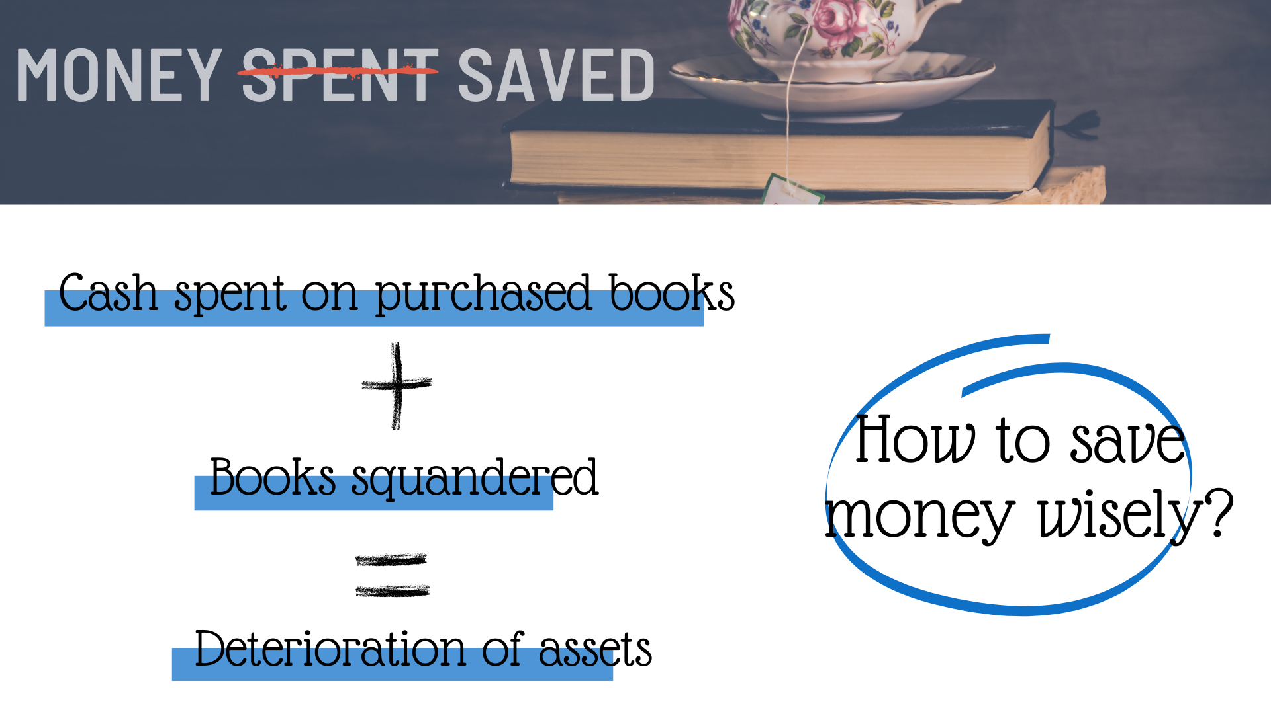
Future Prospects

Slide 10


Slide 11
THANK YOU!

